Slide 1
Perspective Projection
(Simple Purpose)

Slide 2
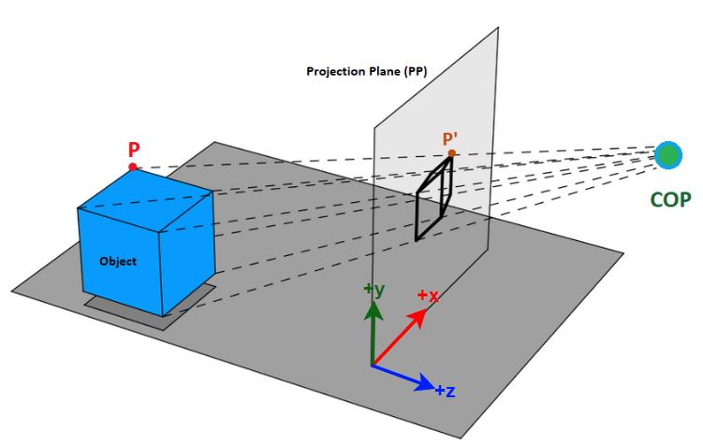
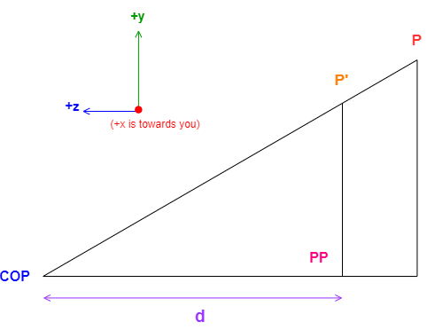
Perspective Projection Overview

Slide 3
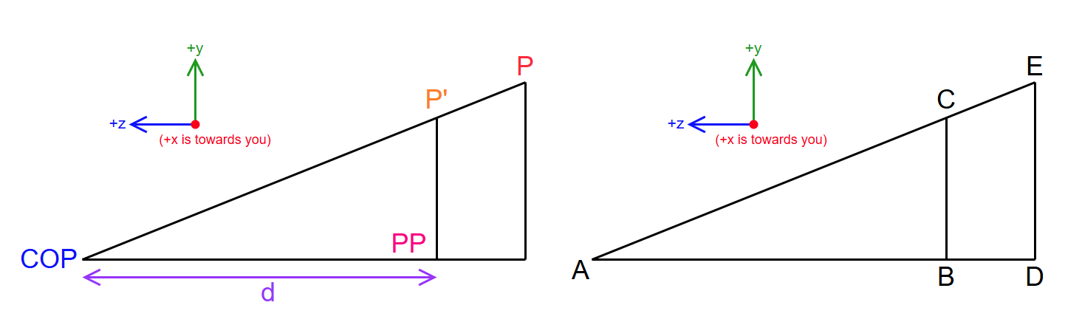
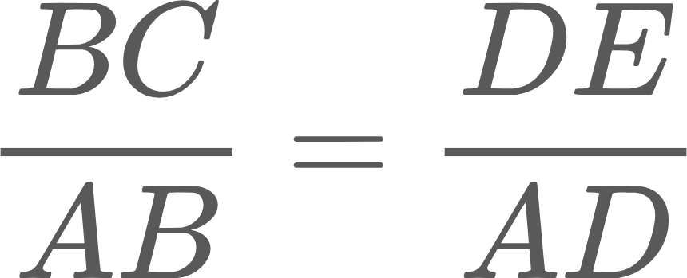
Objective: We need to calculate P'(x', y', z') from P(x, y, z), so we need to derive the equations for x', y', z'
We know that for such triangle,

Slide 4
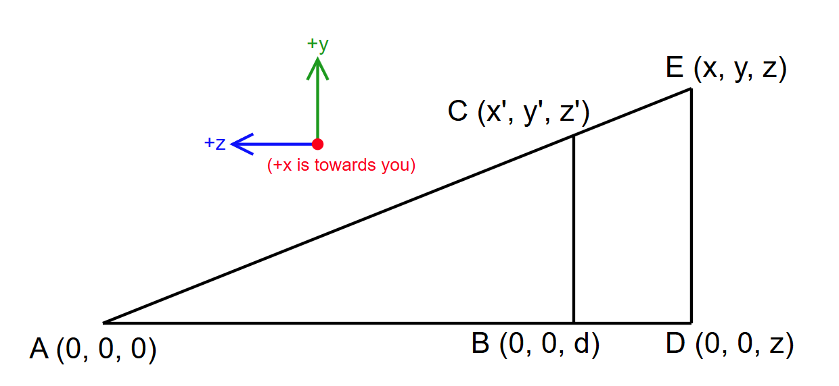
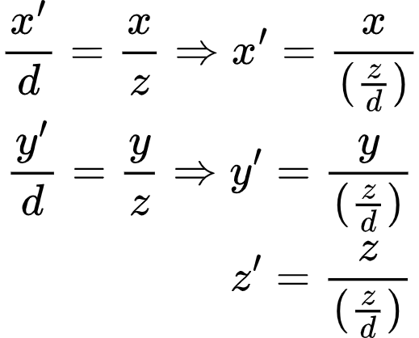
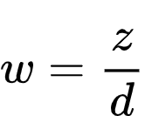
Scenario: COP is at origin (0, 0, 0)
Note: value of d is inherently negative in this scenario
Using the Relation
We perform for each axis
We have got the equations for x', y', z'. Notice how their denominators are same (z/d). We can declare this denominator as "w"

Slide 5
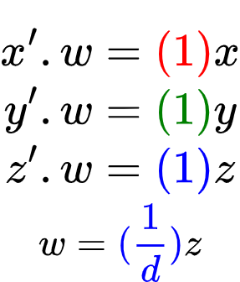
Scenario: COP is at origin (0, 0, 0)
Rearranging (and color coding coefficients for your convenience)
Moving the denominator a.k.a "w" to the L.H.S.
Now we can build the matrix!
Coefficients Color Coding:
(x = red, y = green, z = blue, leftover = purple)

Slide 6
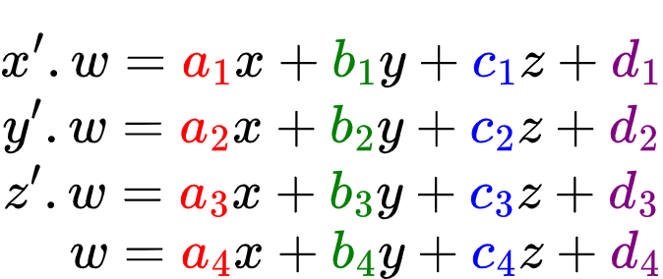
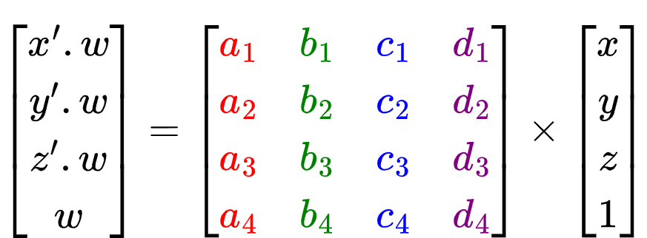
Strategy: Converting x', y', z' equations to a 4x4 matrix

Slide 7
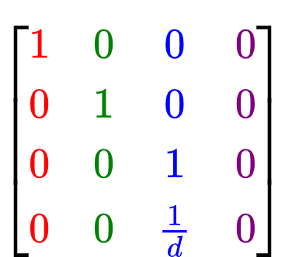
Scenario: COP is at origin (0, 0, 0)
Building the actual matrix from set of equations

Slide 8
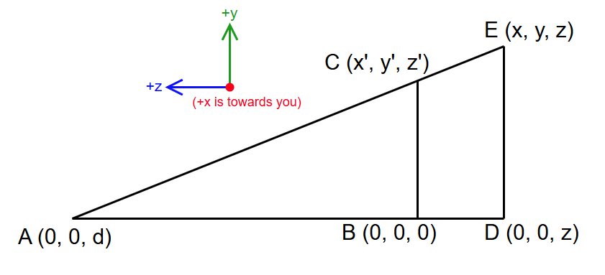
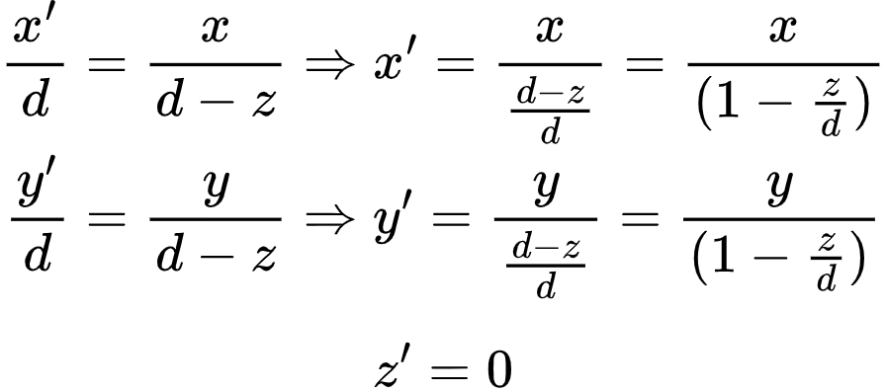
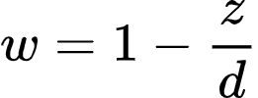
Scenario: Projection Plane is at origin (0, 0, 0)
Note: value of d is inherently positive in this scenario
Using the Relation
We perform for each axis
z' is 0 because it is on the projection plane, which itself is at origin.
We have got the equations for x', y', z'. Notice how their denominators are same (1 - z/d). We can declare this denominator as "w"

Slide 9
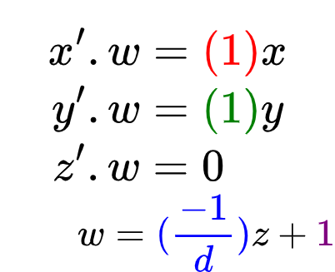
Scenario: Projection Plane is at origin (0, 0, 0)
Rearranging (and color coding coefficients for your convenience)
Moving the denominator a.k.a "w" to the L.H.S.
Now we can build the matrix!
Coefficients Color Coding:
(x = red, y = green, z = blue, leftover = purple)

Slide 10
Recall the Strategy: Converting x', y', z' equations to a 4x4 matrix

Slide 11
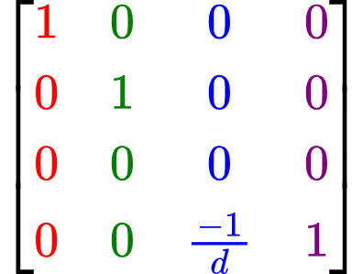
Scenario: Projection Plane is at origin (0, 0, 0)
Building the actual matrix from set of equations

Slide 12
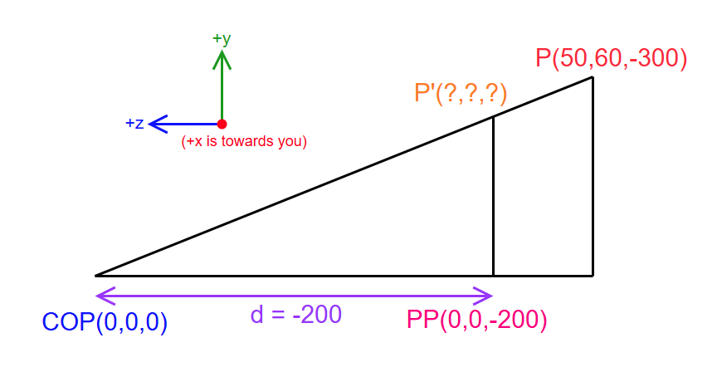
Example: For COP at origin, calculate the projected point P' for a given point P(50, 60, -300), if the plane is 200 units away from the COP.
{ d = z value of PP }
Since the Projection Plane (PP) lies on the negative side of the z-axis, all points on that plane will have a negative z value, which is why d is negative

Slide 13
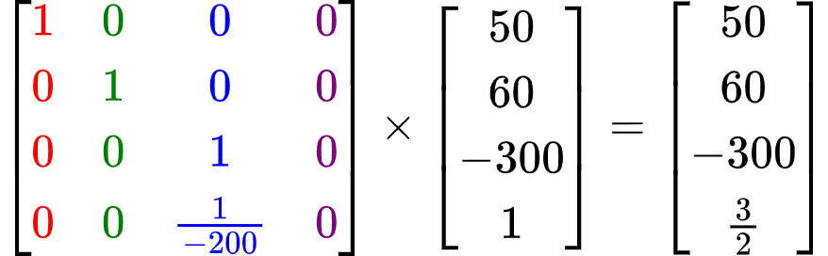
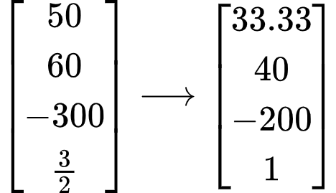
Now' using our matrix for "COP at Origin", we place the d value there, and multiply it by our point P (as a column vector)
Now, divide all the values by w = 3/2 to get the final answer
P' = (33.33, 40, -200)

Slide 14
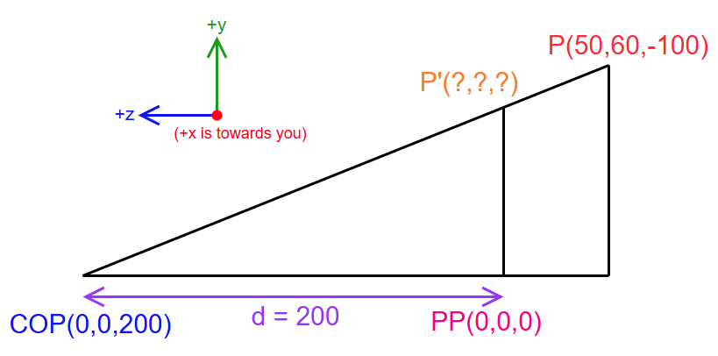
Example: For PP at origin, calculate the projected point P' for a given point P(50, 60, -100), if the plane is 200 units away from the COP.
{ d = z value of COP }
Since the COP lies on the positive side of the z-axis, its z values will be positive, which makes the value of d positive

Slide 15
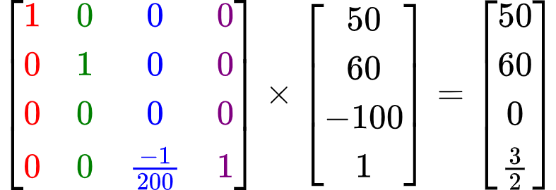
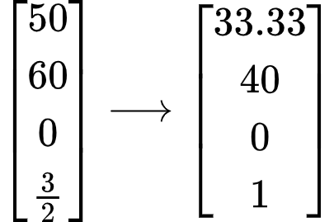
Now' using our matrix for "PP at Origin", we place the d value there, and multiply it by our point P (as a column vector)
Now, divide all the values by w = 3/2 to get the final answer
P' = (33.33, 40, 0)

